Slide 1

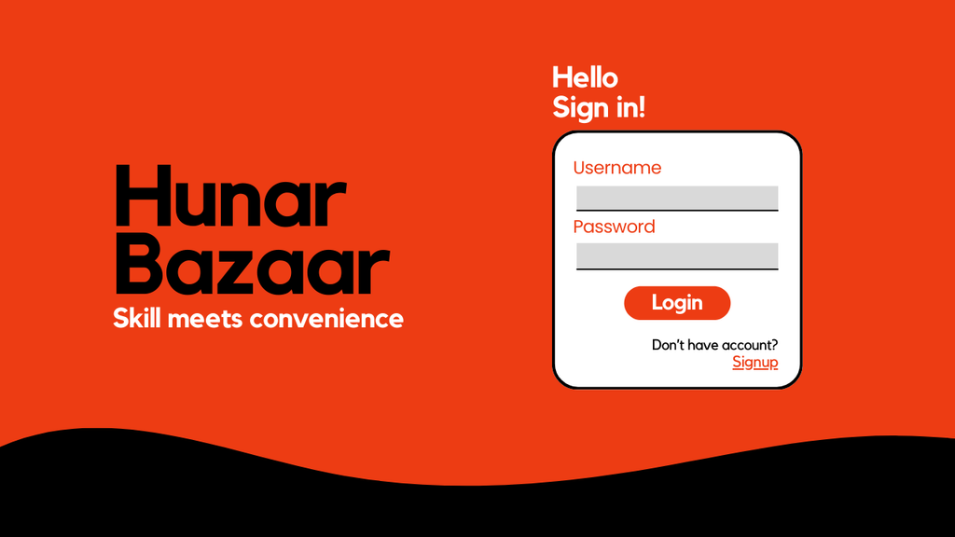

Miusys
Technologies
Hunar Bazaar
By: Ahmed, Usman & Irtaza

Slide 2
PURPOSE
The purpose of HunarBazaar is to create a seamless platform for connecting local technicians—such as plumbers, mechanics, and carpenters—with customers across Pakistan. By providing real-time, location-based solutions, the platform addresses the challenges of finding reliable service providers, especially during emergencies. The initial version of the product focuses on enhancing access to verified professionals in major cities like Karachi, Lahore, and Islamabad, ensuring convenience for users and growth opportunities for technicians.

Slide 3
JavaFX
UI LAYER

Slide 4
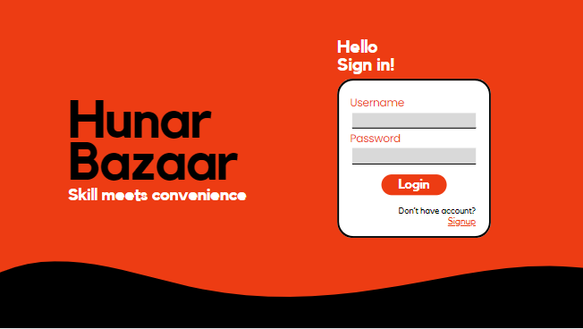
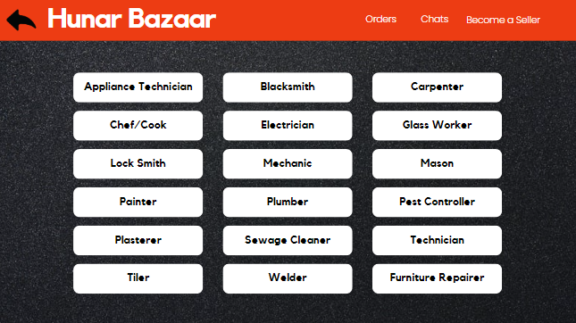
UI LAYER
LOGIN
CATEGORIES

Slide 5
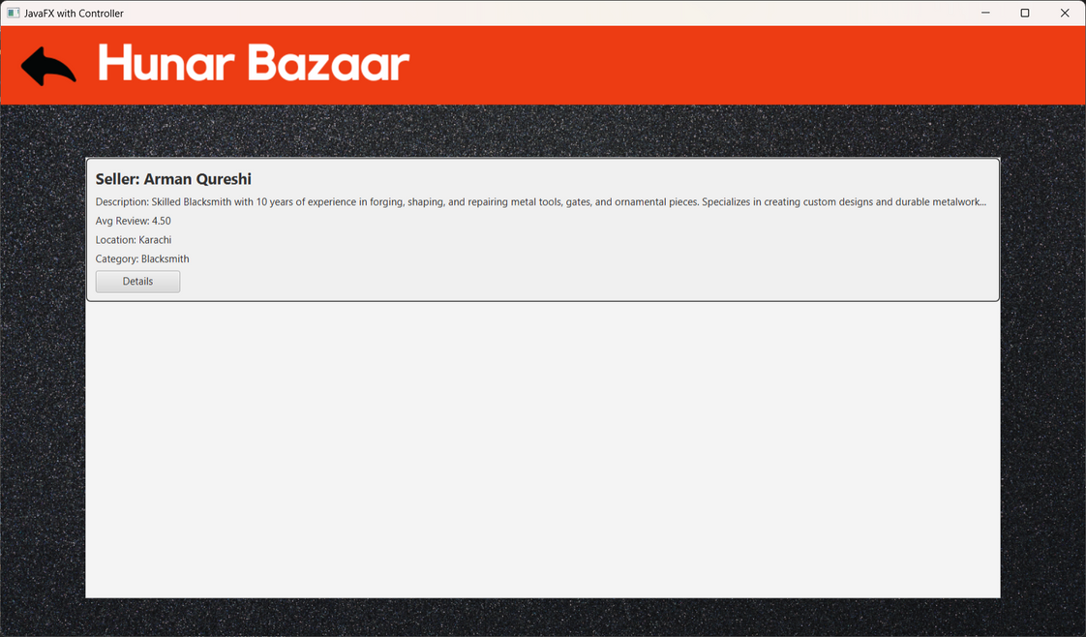
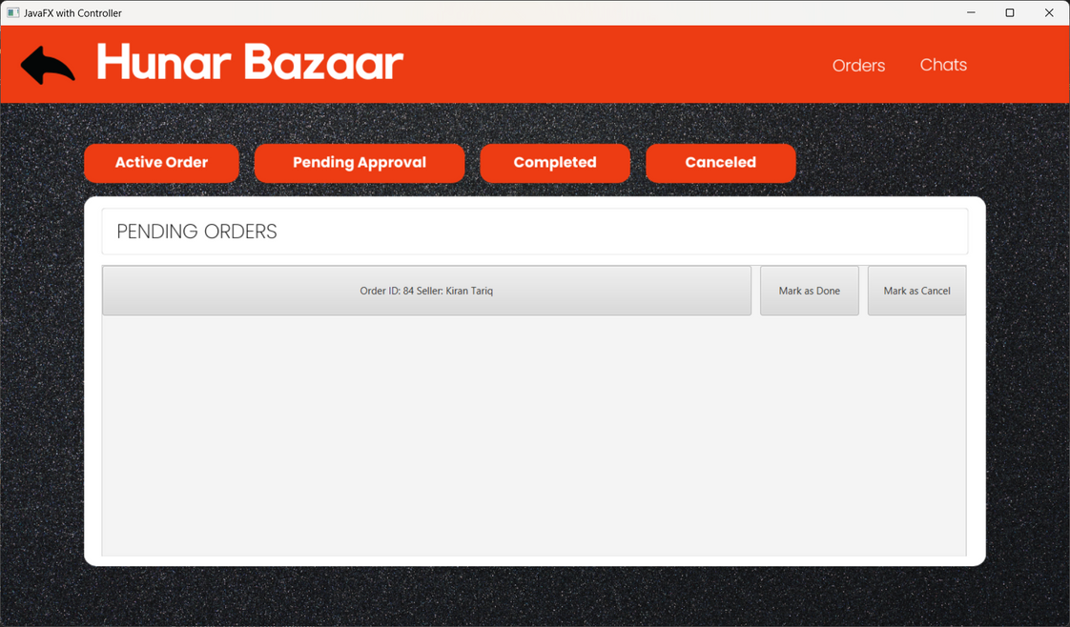
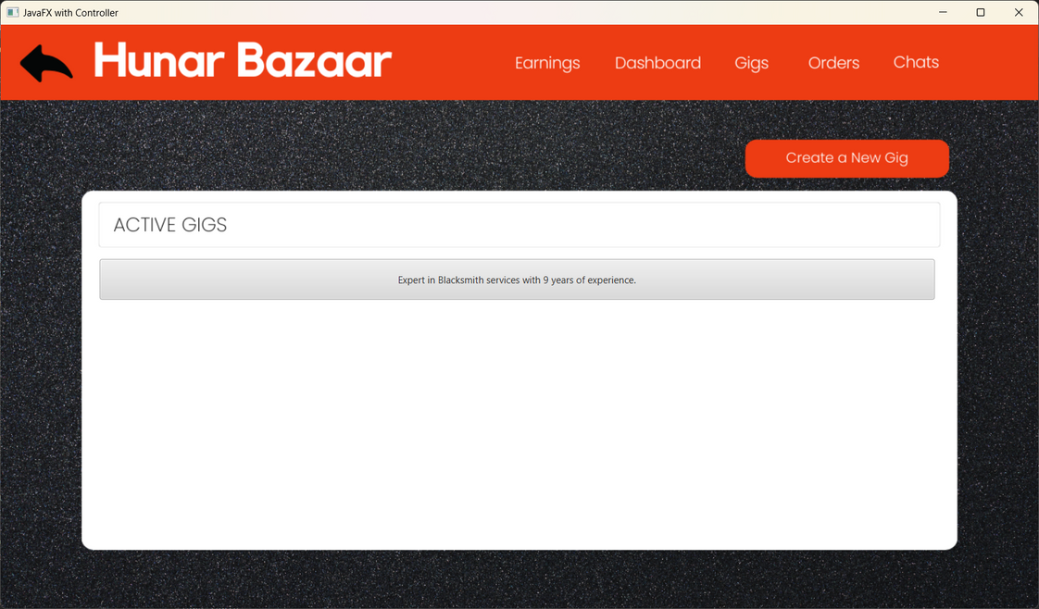
GIGS
ORDERS
MANAGE GIG

Slide 6
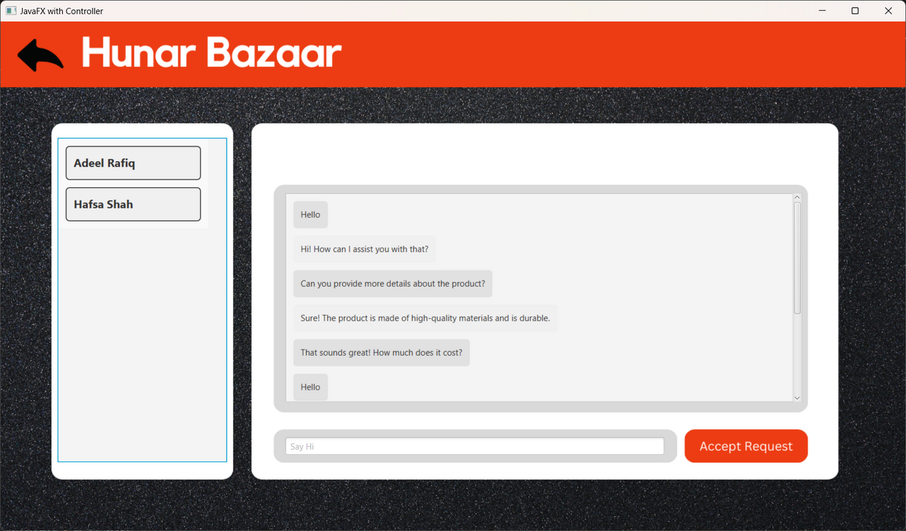
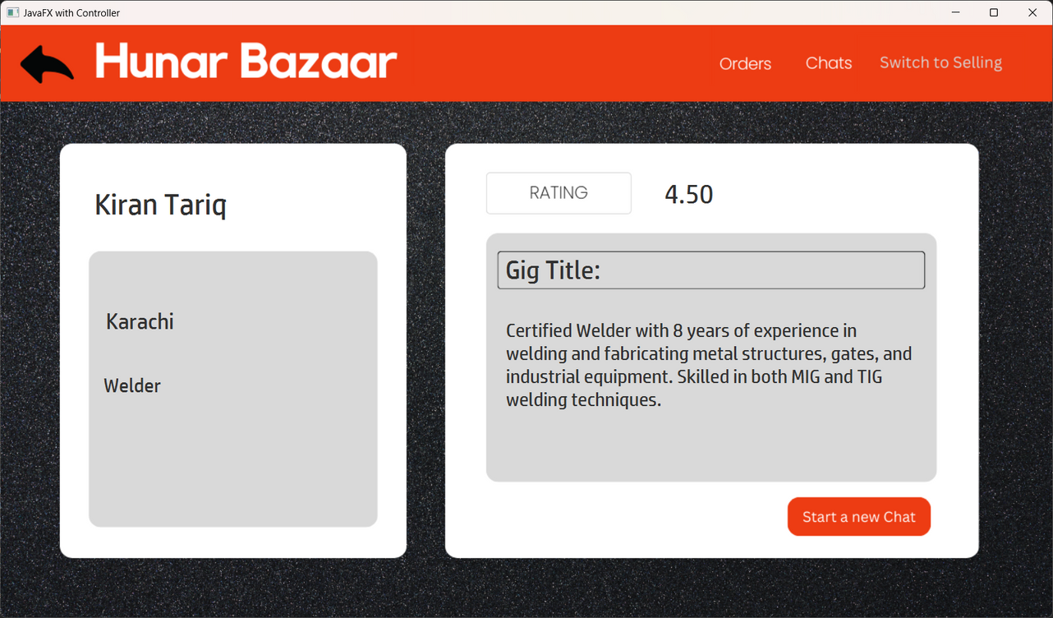
INFO UI
CHAT UI

Slide 7
DESIGN PATTERNS
Low Coupling
High Cohesion
Factory
Singleton
Strategy
...

Slide 8
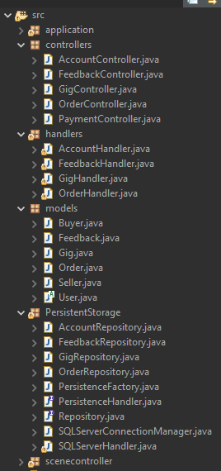
HIGH
COHESION

Slide 9
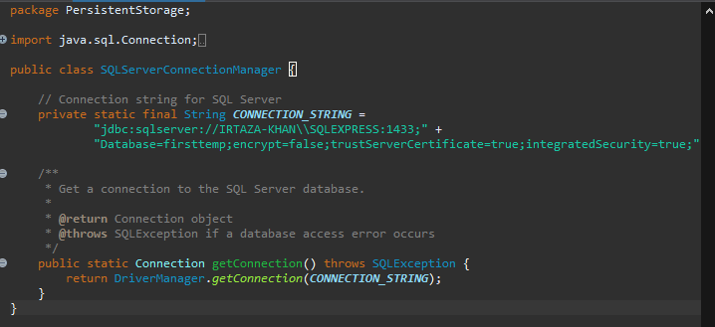

Slide 10
SINGLETON
FACTORY

Slide 11
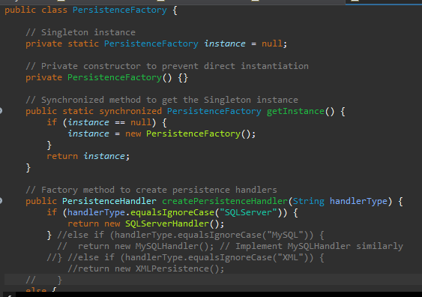

Slide 12
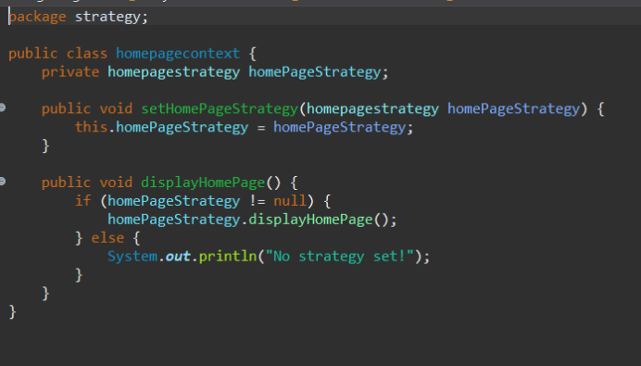
STRATEGY

Slide 13
DIAGRAMS

Slide 14
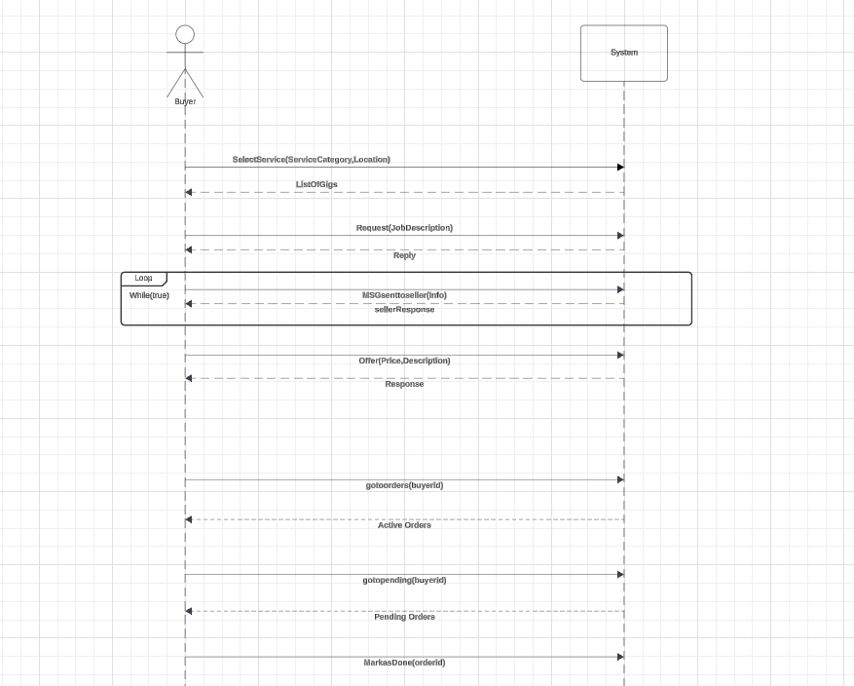
SSD for Buyer

Slide 15
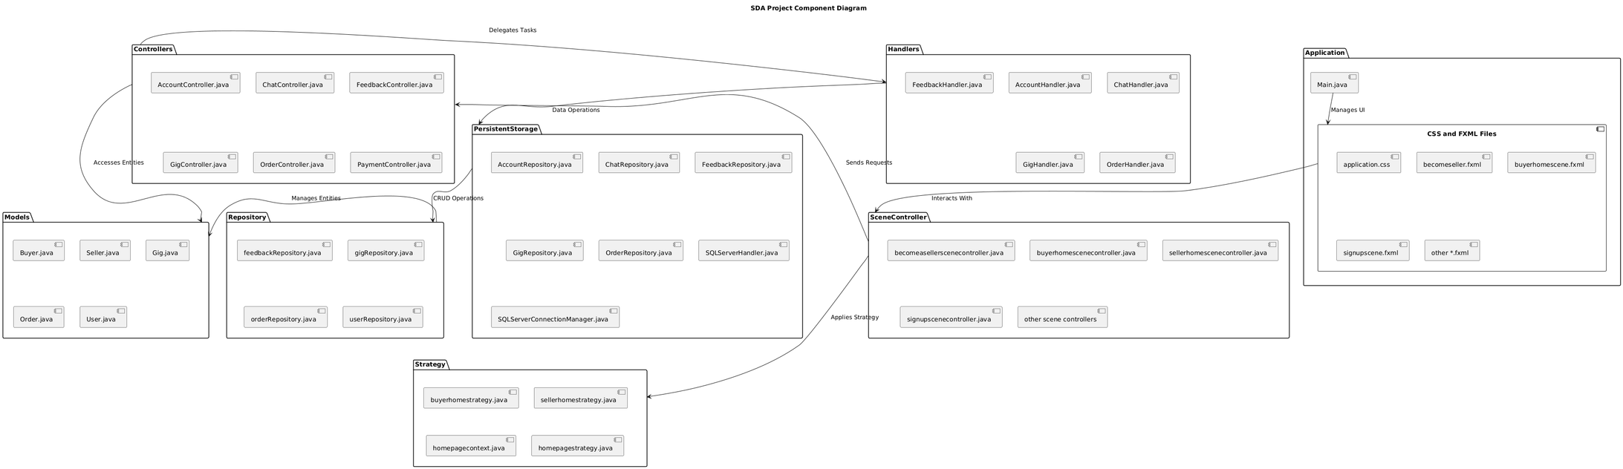
COMPONENT
DIAGRAM

Slide 16
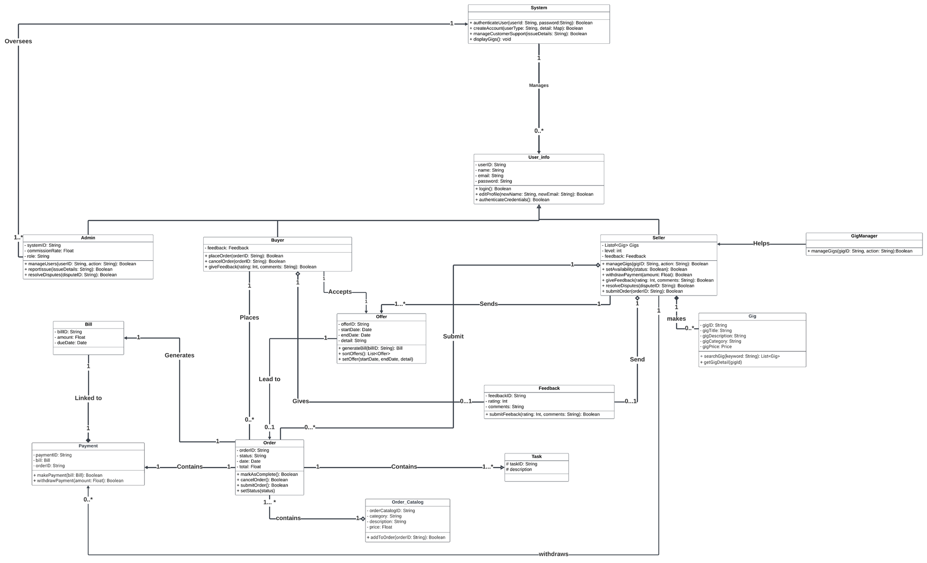
CLASS DIAGRAM

Slide 17
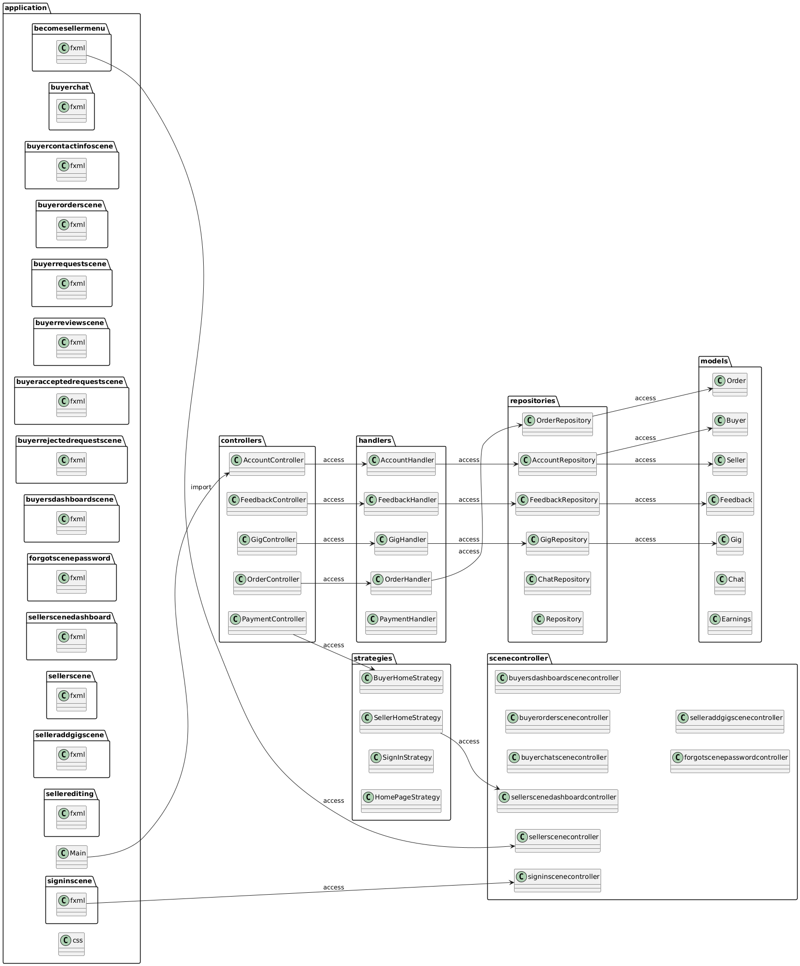
PACKAGE DIAGRAM

Slide 18
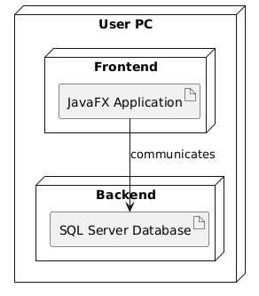
DEPLOYMENT
DIAGRAM

Slide 19
THANK YOU

